Slide 1
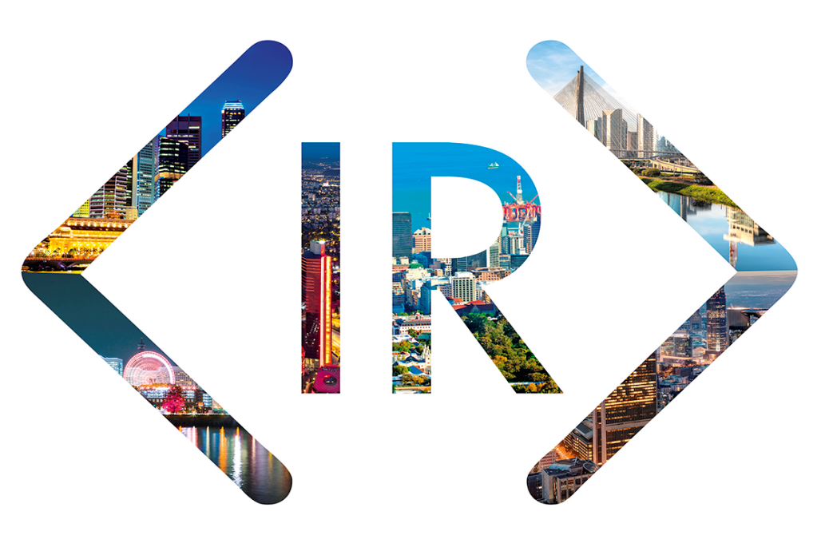

International
Integrated Reporting
Council

Slide 2

Who is the IIRC?
Regulators
Investors
Standard
setters
Companies
Accounting
NGOs
Chair: Prof Mervyn King
CEO: Paul Druckman
Notes:
The International Integrated Reporting Council (IIRC) is a global coalition of regulators, investors, companies, standard setters, the accounting profession and NGOs.
Together, this coalition shares the view that communication about value creation should be the next step in the evolution of corporate reporting.
The International Integrated Reporting Framework has been developed to meet this need and provide a foundation for the future.
The IIRC is chaired by Professor Mervyn King, and Paul Druckman is Chief Executive Officer.
The IIRC is the global authority on <IR>. Its mission is clear: to enable integrated reporting to be embedded into mainstream business practice in the public and private sectors.

Slide 3
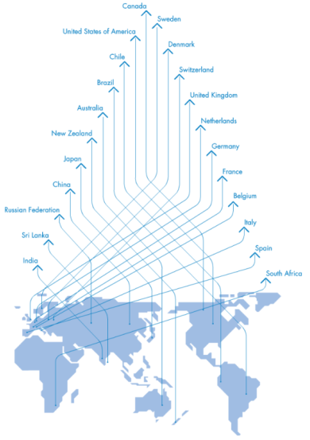
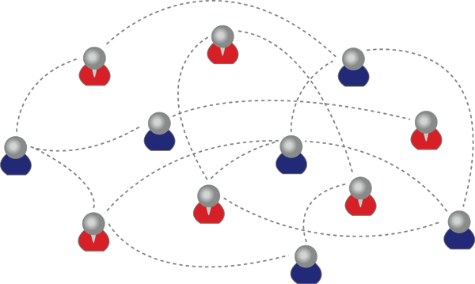
IIRC Pilot Programme
Business Network
Investor Network
Notes:
The IIRC Pilot Programme underpinned the development of the International <IR> Framework.
The group of organizations participating in the IIRC Pilot Programme contributed to the development of the Framework, and demonstrate global leadership in this emerging field of corporate reporting.
The Pilot Programme is the IIRC ‘innovation hub’ – made up of organizations who want to push the boundaries just that little bit further, to challenge, or at least question orthodox thinking, and to acknowledge the importance of reporting to the way our organizations think and behave.
The Pilot Programme is made up of over 100 organizations in its Business Network and over 35 investors in the Investor Network
Examples of organizations in the Businesses Network:
China Light Power
Deutsche Bank
HSBC
Unilever
Microsoft
Hyundai Engineering and Construction
Examples of the Investor Network:
DWS Investments (Deutsche Bank)
Goldman Sachs
Hermes
Government Employee Pension Fund of South Africa
Natixis Asset Management
Some of the Pilot Programme have formed Regional Networks that give them the ability to evaluate the cultural and local impact of implementing <IR> with others in their region.

Slide 4
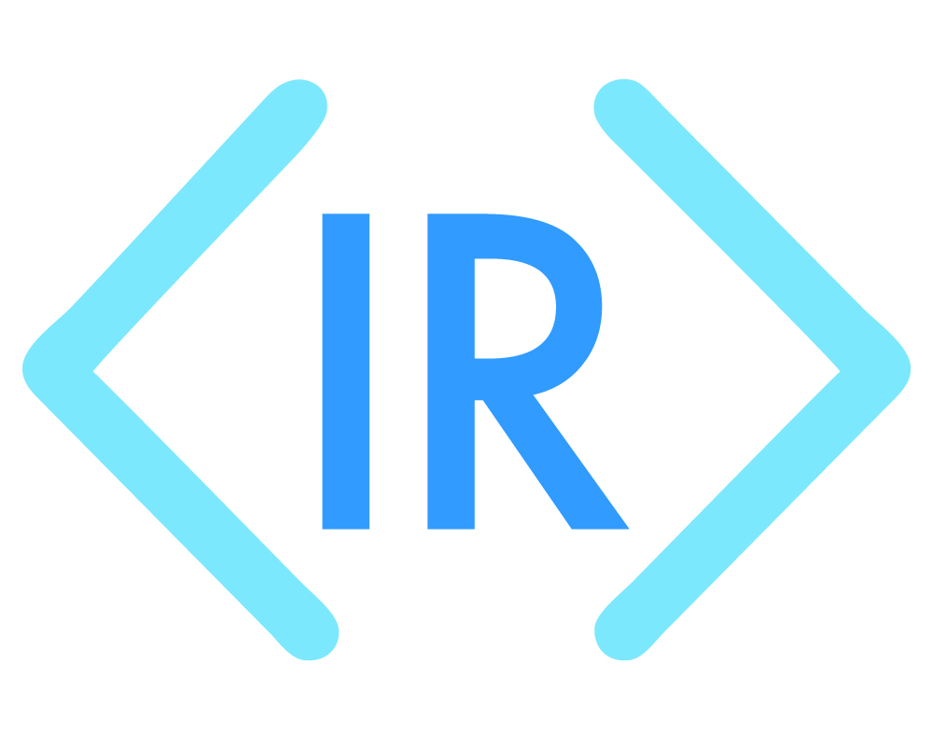
Long Term Vision
Our long-term vision is a world in which integrated thinking is embedded within mainstream business practice in the public and private sectors, facilitated by <IR> as the corporate reporting norm.
The cycle of integrated thinking and reporting, resulting in efficient and productive capital allocation, will act as forces for financial stability and sustainability.
Notes:
Our long-term vision is a world in which integrated thinking is embedded within mainstream business practice in the public and private sectors, facilitated by <IR> as the corporate reporting norm. The cycle of integrated thinking and reporting, resulting in efficient and productive capital allocation, will act as forces for financial stability and sustainability.

Slide 5
Outline
Why <IR>?

Slide 6
Why <IR>
The macro perspective:
Financial stability
Sustainability
In practical terms:
Concise communication of value – more than financial capital
Focus on strategy and future orientation
Reduce volume
Promote connectivity of information
Notes:
The key messages for ‘why <IR>’ are outlined in this slide.
From a Macro perspective the need for <IR> stems from the need for financial stability and sustainability.
The world must challenge the orthodox thinking and behaviour which made instability and short-termism features of the global economy. Institutions, policies and frameworks that build financial stability and promote sustainability have never been more important as the economy, society and environment all adapt to a “new normal” of volatility.
The IIRC offers a framework that provides businesses with the means to make a clear and simple transition to this new way of thinking and behaving, creating the impetus for Integrated Reporting, which results in tangible internal and external benefits that drive momentum for further change within the business.
We live in an information age where demand for more disclosure is increasing. <IR> seeks to put the calls for greater transparency in context - providing a filter that enables the production of concise, decision-useful information required by providers of financial capital.
This enhanced communication between businesses and investors, will lead to allocation of financial capital to businesses that can demonstrate the ability to create value in the short, medium and long term. This will result in investors having a better understanding of the businesses they invest in and thus the wherewithal to make longer-term investments with reduced risk.
In practical terms:
A wide range of factors determine the value of an organization – some of these are easy to account for in financial statements, like cash, debtors, inventory, land, machinery, buildings, etc. But many are not (e.g. employee loyalty and motivation, “free” natural resources, and relationships with customers, suppliers, business partners, and local communities). A business’ value is not determined just by the assets recorded in its balance sheet, but also by these other forms of capital. <IR> focuses on all the capitals a business uses and affects and how they in turn affect its ability to create value in the short, medium and long term.
<IR> corrects the imbalance of current reporting. Currently, reporting primarily focuses on past performance. <IR> shifts the focus towards strategy and future orientation – reflecting a business’ value and strategic plans. This means investors have the information they need to get a clear picture of value creation over time.
Information is the lifeblood of capital markets; and the volume of today’s corporate reports demonstrates that businesses are providing this information. Yet what <IR> provides is clarity of information: a reduction in volume. This leads to transparency with a purpose – the purpose to transform the behaviour of both businesses and investors.
Integrated Reporting takes into account the connectivity and interdependencies between the range of factors that affect an organization’s ability to create value over time.
The IIRC does not aim to increase the reporting burden of an organization, but enable a business to bring more coherence and focus to their dialogue with stakeholders.

Slide 7
Why <IR>: Volume of reports
Source: Investis Research
Notes:
Reports have become so long that the key messages are often lost. <IR> prompts clear and concise reporting in order to ensure important information is accessible. <IR> is about better reporting – not more reporting. As this graph shows, in 2008, Prudential had far too much information!

Slide 8
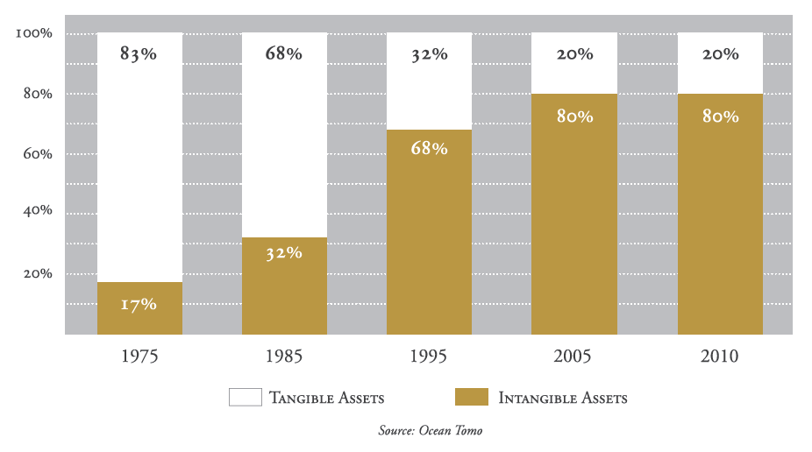
Why <IR>: More than financials
Notes:
-The Standard & Poor’s stock market index of the top 500 publically traded American companies.
-This graph demonstrates that:
- In the 1970’s 80% of a company’s market value could be traced through to the tangible assets in the financial statements.
Today, only around 20% of a company’s market value can be accounted for by its financial and physical assets.
Other factors, such as relationships, intellectual and human capital, make up an increasing proportion of a company’s value.
<IR> enables the clear and concise communication of value creation, allowing investors to evaluate how all relevant capitals that a business uses and affects are incorporated.
The IIRC is not trying to monetize everything (which is a common misperception), but rather is trying to ensure investors have the information they need to assess the ability of an organization to create value over time.

Slide 9
Why <IR>: The reporting mismatch
Reporting content
Business value
STRATEGIC ISSUES
STRATEGY AND GOVERNANCE
FORECASTS / PLANS
PAST PERFORMANCE
IMPLEMENTATION PLANS
BUSINESS AS USUAL
Notes:
Part of what <IR> does is shift the focus to strategy and future orientation, rebalancing the current mismatch between what is reported and those factors that impact value. <IR> ensures issues central to value are getting the attention they deserve, enabling investors to have the information they need to get a clear picture of the long term. Currently capital markets compensate for not having this information by pricing in risks that may well be adequately managed.

Slide 10
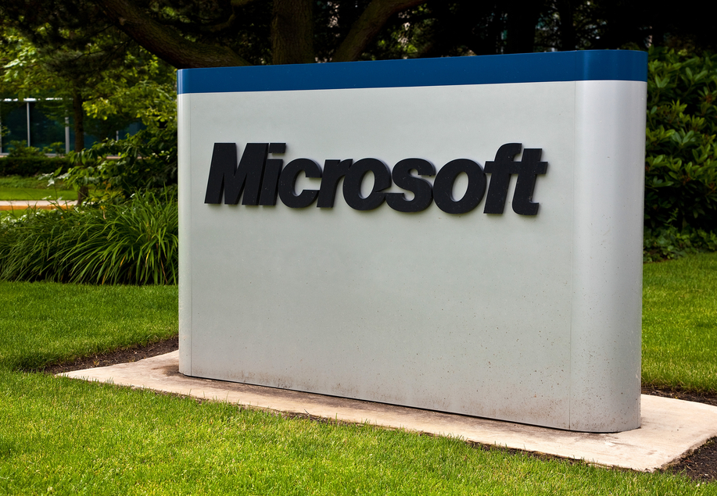
Why should you care about <IR>?
Communicating vs. Complying
Reporting the Intangibles
Breaking Down Silos
Increasing Transparency
Bob Laux
Senior Director of Financial Accounting and Reporting
Microsoft Corporation
AICPA Insights Article
Notes:
Bob Laux, Senior Director of Financial Accounting and Reporting Microsoft Corporation, AICPA Insights Article writes ‘why you should care about <IR>’:
1. Communicating vs. Complying
A lot of financial executives have complained about the state of financial reporting. It seems like a compliance exercise versus a mechanism for communicating business performance. We need to get out of the compliance mindset and embrace mechanisms that tell the organization’s financial story in the best—and most transparent way. <IR> provides a holistic method for explaining how the organization is doing, and how the management team thinks it will do in the future.
2. Reporting the Intangibles
It’s not just about physical or financial assets any more: The value drivers of a company are increasingly intangible, not just tangible assets, such as intellectual and human capital. The transformation from a manufacturing economy to an information economy (or knowledge) has not been matched by similar changes in financial reporting. <IR> provides a holistic view that helps organizations rooted in the information age (or knowledge) report on their real sources of value and accomplishments beyond financial results.
3. Breaking Down Silos
Integrated thinking is the active consideration by an organization of the relationships between its various operating and functional units and the capitals that the organization uses and affects. Integrated thinking leads to integrated decision-making and actions that consider the creation of long term, as well as short and medium term, value.
Integrated thinking can be contrasted with traditional ‘silo thinking’. It takes into account the connectivity and interdependencies between the range of factors that have a material effect on an organization’s ability to create value over time.
4. Increasing Transparency
Integrated reporting is a concept designed to improve transparency and help organizations communicate more information about performance to investors. Using integrated reporting, CFOs have a chance to take a leadership role in telling the company story in a more effective way, making an even bigger impact on their organizations.

Slide 11
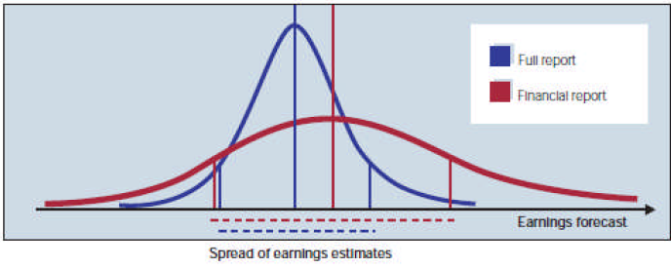
The benefit of giving the full story
PwC took two reports to two teams at Schroders Investment Management House.
1st team studied Coloplast’s ‘full report’
2nd team studied a stripped version ‘financial report’
Conclusion: “ There is a competition for capital out there – every company needs to question whether its corporate reporting is positioning them for success”
Source: PwC
Notes:
For the experiment, PwC created an edited version on Coloplast’s annual report that omitted all of the contextual information and non-financial data. This modified, pared-down version of the report complied with accounting standards and included the sort of narrative that companies typically provide in annual reports, but nothing more.
Different teams of analysts were then given either the original or the edited version of the report, but not both, and asked to provide a “buy” or “sell” recommendation for the stock.
60% of the analysts with more complete information recommended BUYING stock
80% of the analysts with less complete information recommended SELLING the stock.

Slide 12
Outline
What is <IR>?

Slide 13

<IR>: A new focus
concise communication about value
strategy, governance,
performance, prospects
Other
reporting
Financial
reporting
Notes:
<IR> is consistent with developments in financial and other reporting, but an integrated report also differs from other reports and communications in a number of ways. In particular, it focuses on the ability of an organization to create value in the short, medium and long term, and in so doing it:
is a concise communication about how an organization’s strategy, governance, performance and prospects, in the context of its external environment, lead to the creation of value over the short, medium and long term.
Has a combined emphasis on conciseness, strategic focus and future orientation, the connectivity of information, and the capitals and their interdependencies
Emphasizes the importance of integrated thinking within the organization.

Slide 14
What is <IR>?
integrated thinking
Integrated Reporting
integrated report
Notes:
Integrated Reporting <IR>: A process founded on integrated thinking that results in a periodic integrated report by an organization about value
creation over time and related communications regarding aspects of value creation.
Integrated report: A concise communication about how an organization’s strategy, governance, performance and prospects, in the context of its external environment, lead to the creation of value in the short, medium and long term.
Integrated thinking: The active consideration by an organization of the relationships between its various operating and functional units and the capitals that the organization uses or affects. Integrated thinking leads to integrated decision-making and actions that consider the creation of value over the short, medium and long term.

Slide 15
<IR> aims to:
Efficient and productive allocation of capital
Support integrated thinking
Cohesive and efficient approach to corporate reporting
Enhance
accountability
Notes:
<IR> aims to:
• Improve the quality of information available to providers of financial capital to enable a more efficient and productive
allocation of capital
• Promote a more cohesive and efficient approach to corporate reporting that draws on different reporting strands and
communicates the full range of factors that materially affect the ability of an organization to create value over time
• Enhance accountability and stewardship for the broad base of capitals (financial, manufactured, intellectual, human, social
and relationship, and natural) and promote understanding of their interdependencies
• Support integrated thinking, decision-making and actions that focus on the creation of value over the short, medium and long
term.

Slide 16
The Framework
International <IR> Framework

Slide 17
The Framework: Core features
Fundamental Concepts
Guiding Principles
Content Elements
Value Creation for the organization and for others
The Capitals
The Value Creation Process
Notes:
The Framework has 3 core parts:
Fundamental concepts that explain the foundations or conceptual underpinning of <IR>,
Guiding Principles that inform the content of an integrated report and how information in the report is presented, and
Content Elements, which are essentially categories of information that are to be included in an integrated report.
Fundamental Concepts: An integrated report aims to provide insight about the resources and relationships used and affected by an organization – these are collectively referred to as “the capitals” in this Framework. It also seeks to explain how the organization interacts with the external environment and the capitals to create value over the short, medium and long-term.

Slide 18
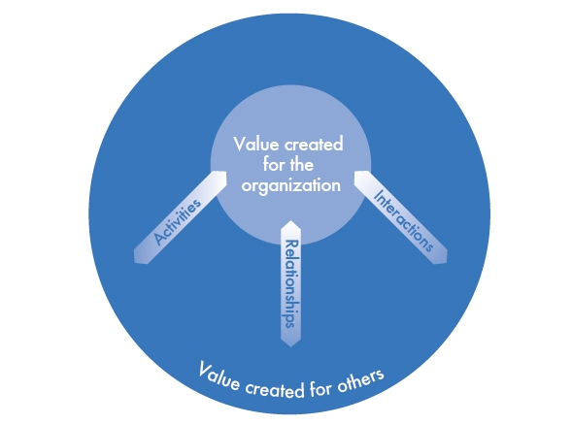
The Framework: Fundamental Concepts
Notes:
<IR> explains how an organization creates value over time. Value creation, therefore, lies right at the heart of <IR>.
Providers of financial capital are interested in the value an organization creates for itself. They are also interested in the value an organization creates for others when it affects the ability of the organization to create value for itself, or relates to a stated objective of the organization (e.g., an explicit social purpose) that affects their assessments.
The ability of an organization to create value for itself is linked to the value it creates for others. This happens through a wide range of activities, interactions, and relationships in addition to those, such as sales to customers, that are directly associated with changes in financial capital. These include, for example, the effects of the organization’s business activities and outputs on customer satisfaction, suppliers’ willingness to trade with the organization and the terms and conditions upon which they do so, the initiatives that business partners agree to undertake with the organization, the organization’s reputation, conditions imposed on the organization’s social licence to operate, and the imposition of supply chain conditions or legal requirements.
When these interactions, activities, and relationships are material to the organization’s ability to create value for itself, they are included in the integrated report.

Slide 19



6 capitals with different combinations and connectivity
Notes:
In this slide the 6 faces of the Rubik’s cube represent the 6 capitals
It is not the purpose of an integrated report to categorize each capital like in the first cube
It is the combination and connectivity of information that makes each organization different and unique – there are 4.30 x 10 to the power of 19 (43,252,003,274,489,856,000) combinations in a Rubik’s Cube!
The cubes are connected very tightly – ‘trade-offs’ always happen – each organization looks to solving such trade-offs in pursuing its strategy, and shows in an integrated report how the various capitals are connected.
Traditionally, “capital” has been thought of as the money and machines available for production; what the Framework calls Financial Capital and Manufactured Capital. These have been accounted for in financial statements since the beginning of double-entry bookkeeping.
But “Capital” in this sense is only one part of what are commonly called the “factors of production”, i.e., “land, labour and capital”. And any business needs all these factors of production to prosper.
The fact is that the other factors of production (land and labour) are actually forms of capital too, in that they store value that can be enhanced, consumed, modified, destroyed or otherwise affected by an organization.
So in reality, all organizations depend on a whole range of capitals (or “resources and relationships”) for their continued success.
To get the full picture of an organization’s ability to create value, therefore, all the capitals need to be considered.
The Framework classifies the capitals as, starting with the traditional ones:
FINANCIAL: The pool of funds an organization has access to
MANUFACTURED: Plant, machinery and infrastructure used in the production of goods and service
Then there is a layer of capitals that have to do with humans (the equivalent of “labour” in the factors of production)
INTELLECTUAL: Organizational, knowledge-based intangibles
SOCIAL AND RELATIONSHIP: The institutions and relationships established within and between communities, groups of stakeholders and other networks, and their ability to share information, to enhance individual and collective well-being.
HUMAN: People’s competencies, capabilities and experience and their motivations to innovate
And finally there is natural capital (the equivalent of “land” in the factors of production)
NATURAL: Both renewable and non-renewable environmental resources and processes.

Slide 20
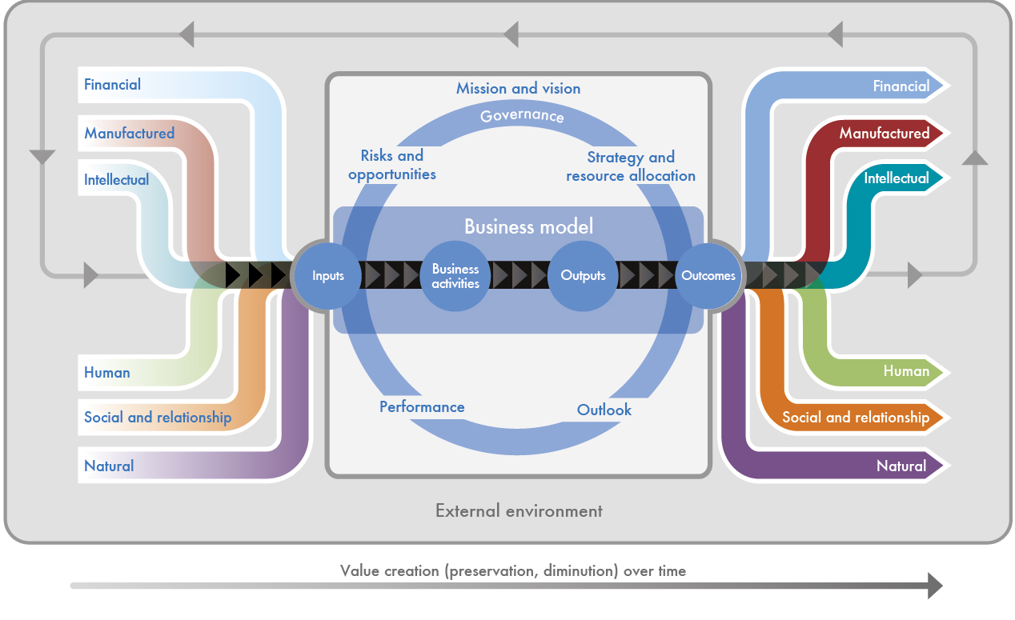
The Framework: Fundamental Concepts
The Value Creation Process
Notes:
An integrated report explains how an organization creates value over time. Value is not created by or within an organization alone. It is influenced by the external environment, created through relationships with stakeholders and dependent on various relationships.
An integrated report therefore aims to provide insight about:
The external environment that affects an organization
The resources and the relationships used and affected by the organization, which we refer to as capitals
How the organization interacts with the external environment and the capitals to create value over the short, medium and long term.
The external environment, including economic conditions, technological change, societal issues and environmental challenges, sets the context within which the organization operates.
At the core of the organization is its business model, which draws on various capitals as inputs and, through its business activities, converts them to outputs (products, services, by-products and waste). The organization’s activities and its outputs lead to outcomes in terms of effects on the capitals.
Continuous monitoring and analysis of the external environment in the context of the organization’s mission and vision identifies risks and opportunities relevant to the organization, its strategy and its business model.
The organization’s strategy identifies how it intends to mitigate or manage risks and maximize opportunities. It sets out strategic objectives and strategies to achieve them, which are implemented through resource allocation plans
The value creation process is not static; regular review of each component and its interactions with other components, and a focus on the organization’s outlook, leads to revision and refinement to improve all the components.

Slide 21
The Framework: Core features
Fundamental Concepts
Guiding Principles
Content Elements
Notes:
I will now quickly run you through the Guiding Principles and Content Elements

Slide 22

The Framework: Guiding Principles
Strategic focus and future orientation
Connectivity of information
Stakeholder relationships
Materiality
Conciseness
Reliability and completeness
Consistency and comparability
Underpins preparation
Informs content
Presentation of information
Judgement is needed
Notes:
Guiding Principles underpin the preparation of an integrated report, informing the content of the report and how information is presented
These Guiding Principles are applied individually and collectively for the purpose of preparing and presenting an integrated report; accordingly, judgement is needed in applying them, particularly when there is an apparent tension between them (e.g., between conciseness and completeness).
A Strategic focus and future orientation
B Connectivity of information
C Stakeholder relationships
D Materiality
E Conciseness
F Reliability and completeness
G Consistency and comparability

Slide 23
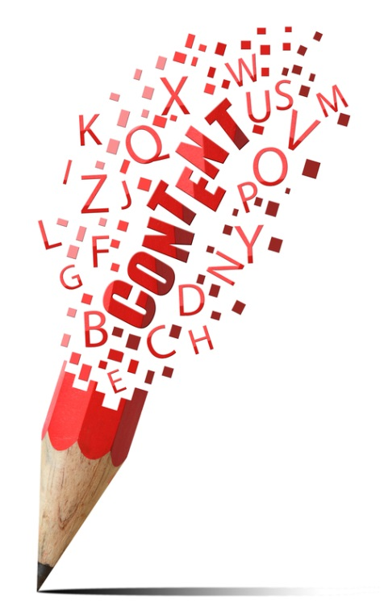
The Framework: Content elements
Organizational overview and external environment
Governance
Business model
Risk and opportunities
Strategy and resource allocation
Performance
Outlook
Basis for preparation and presentation
General reporting guidance
Questions to be answered
Unique story
Connections apparent
Not a set sequence
Not isolated, standalone sections
Notes:
The Content Elements are questions that should be answered in in a way that best expresses the organization’s unique value creation story, and makes the connections between the Content Elements apparent
They are not intended to appear in a set sequence, and they are not isolated – they are fundamentally linked to each other and are not mutually exclusive.

Slide 24
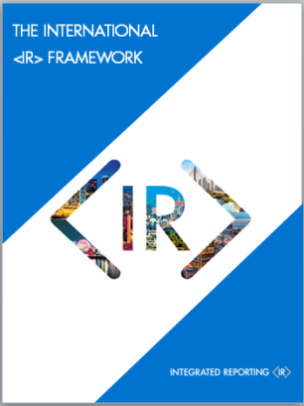

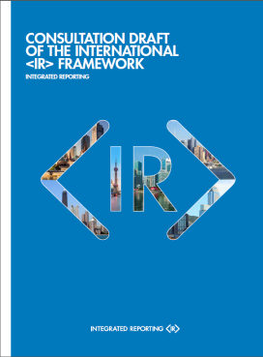
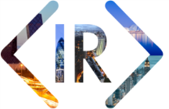
The Framework journey so far…
The Framework journey
Discussion Paper
Prototype Framework
Background Papers for <IR>
Emerging <IR>
Database
IIRC Pilot Programme Yearbooks
Basis for Conclusions
Building the Business Case for <IR>
Summary of
Significant Issues
Notes:
1.The Discussion Paper – September 2011
This paper launched the IIRC and the intention of developing an International <IR> Framework into the market place.
2. Prototype Framework – November 2012
The first working draft of the Framework was released as a “Prototype” following the release of a draft outline in June 2012
3. Consultation Draft – April 2013
This was released on 16 April 2013, and was followed by a public consultation period, where organizations and individuals responded with feedback to help shape the direction of the Framework
4. Along the way we have also released a number of other resources – including: a summary of the comments received on the Discussion Paper; background Papers on Materiality, the Capitals, the Business Model, Value Creation and Connectivity; two IIRC Pilot Programme Yearbooks, research (with Black Sun) on building the business case, and for those who want to see how flesh is being added to the bone of the Framework, a database of emerging practice.
5. Alongside the Framework we released two documents: Basis for Conclusions and a Summary of Significant Issues

Slide 25
The Framework journey ahead
Framework Development
Guidance and Practice
Thought leadership
Academic community
Databases
Evidence Base
Discussion Paper
Prototype Framework
Background Papers for <IR>
Emerging <IR>
Database
IIRC Pilot Programme Yearbooks
Basis for Conclusions
Building the Business Case for <IR>
Summary of
Significant Issues
Notes:
There is much still to do on the road to <IR>:
Although there is a brand new Framework, the IIRC will continue its technical work.
There will be projects that provide guidance for early adopters
There will be projects designed to position the IIRC as a thought leader in the market.
The IIRC will be getting academics engaged on the issues important to the <IR> community
The IIRC will develop databases that showcase the best progress being made by those on the <IR> journey and provide resources that others can access.
Laying out the business case for <IR> will be the foundation of our engagement with businesses and investors, and will inform our engagement with policy-makers

Slide 26
Business applying <IR>
Notes:
I will now run through some examples of how businesses are applying <IR>

Slide 27
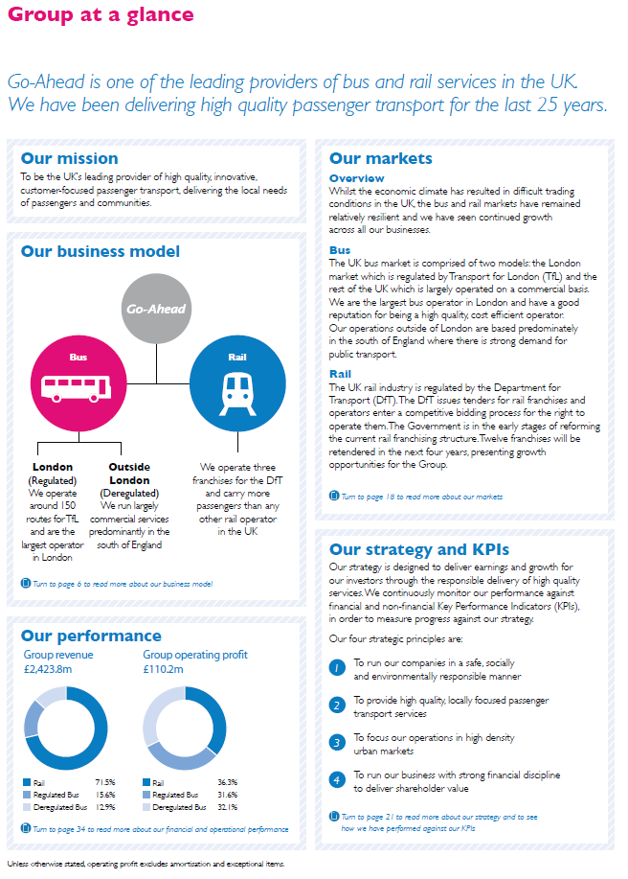
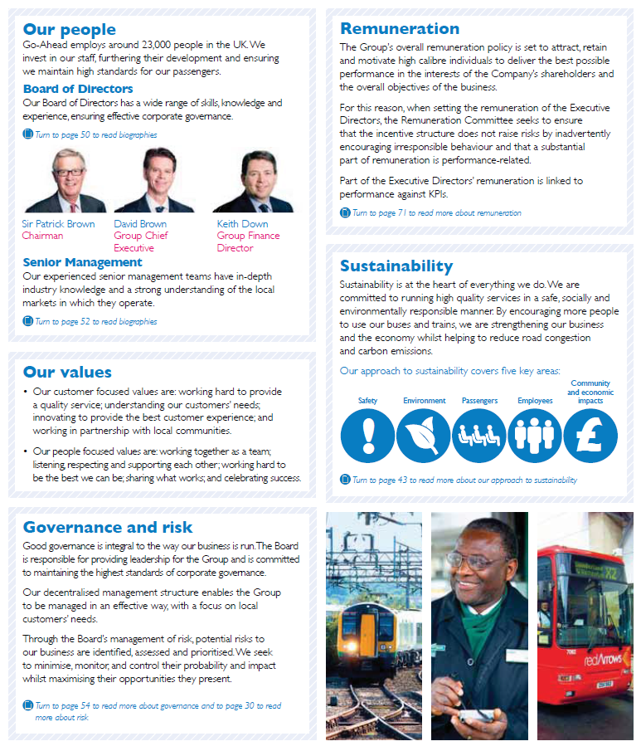
ORGANIZATIONAL OVERVIEW AND EXTERNAL ENVIRONMENT
Notes:
Emerging demonstrations of ‘Organizational Overview and External Environment’

Slide 28
The Go-Ahead Group plc Annual Report and Accounts 2012
Notes:
In an ‘at a glance’ format Go-Ahead addresses a great deal of key information and disclosures in a double page spread. In addition, the section flows nicely, with the mission and market review setting up the strategy, which is followed by the governance and people driving the success of the Group. Go-Ahead provides a great example of how an overview of a complex business can be communicated in a concise and accessible way.

Slide 29
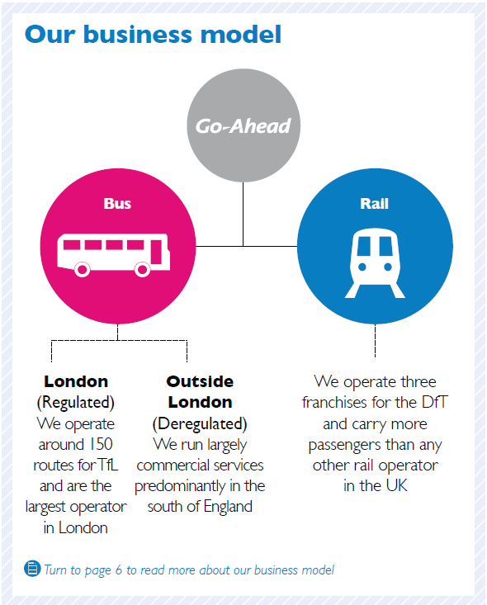
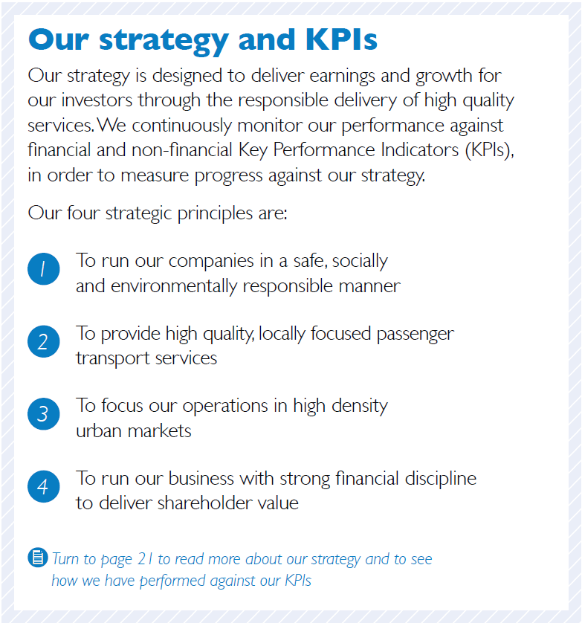
The Go-Ahead Group plc Annual Report and Accounts 2012
Notes:
As you can see on this zoom in - The Go-Ahead Group succinctly give readers an overview of their business model and strategy.

Slide 30
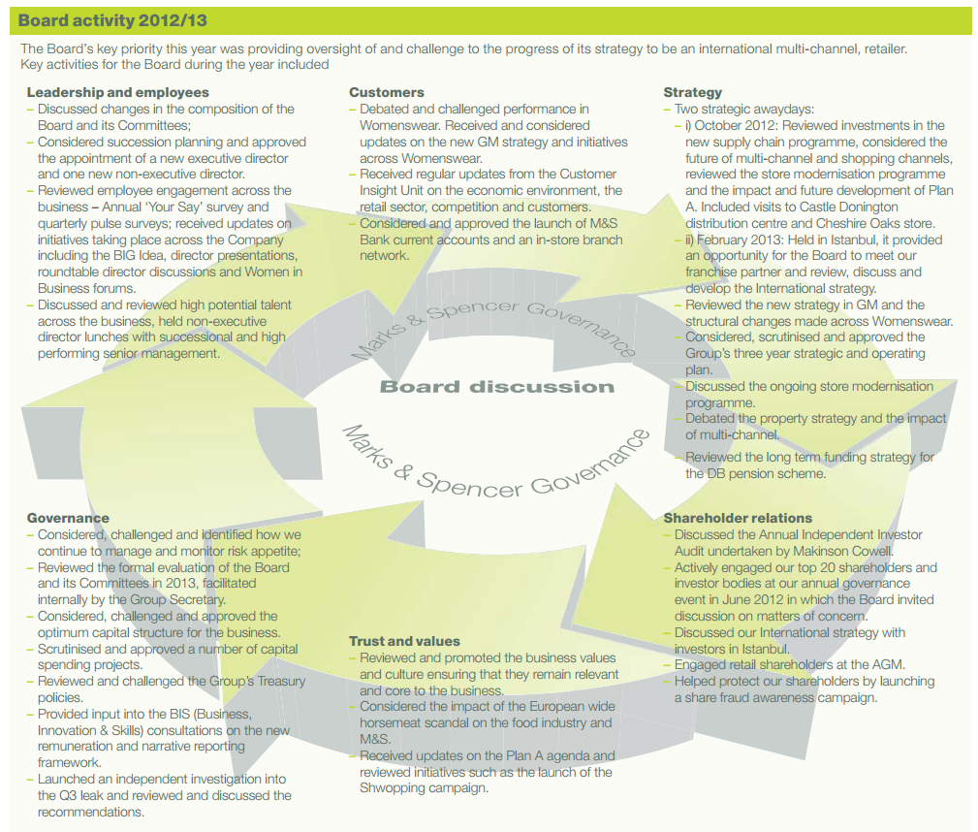
GOVERNANCE
Notes:
Emerging demonstrations of ‘Governance’

Slide 31
Marks & Spencer Group plc Annual Report and Financial Statements 2013
Notes:
Marks & Spencer reviews how the company ensures an effective Board focusing on the Board evaluation process and the resulting outcomes. As a result, an action plan for the coming year is provided, providing a transparent view into the strategic focus of the Board.

Slide 32
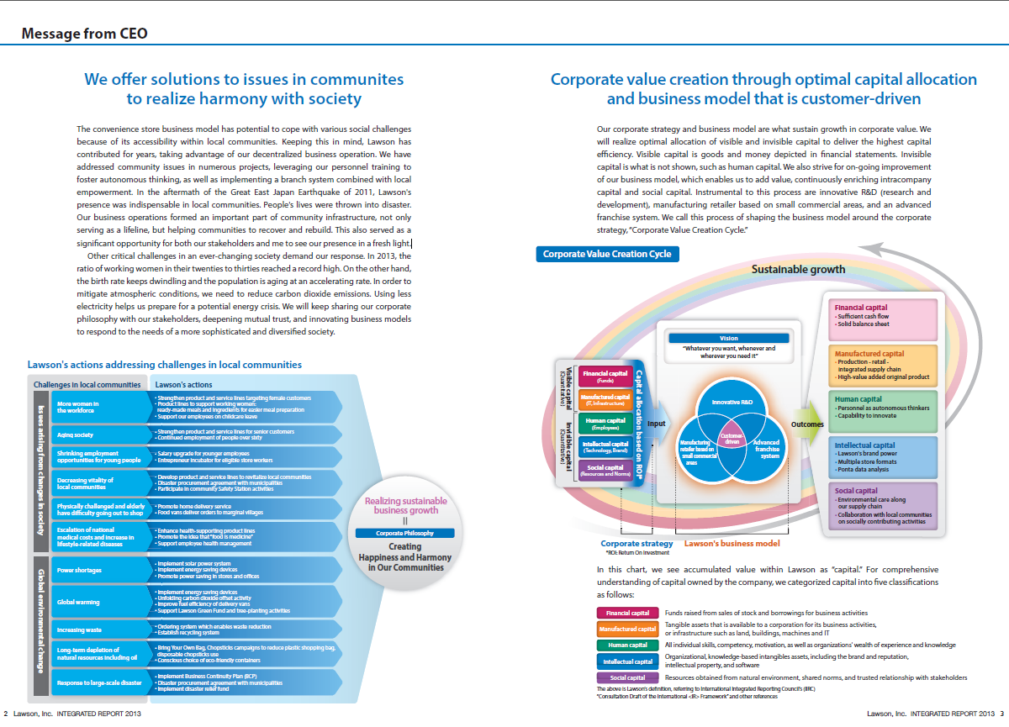
BUSINESS MODEL
Notes:
Emerging demonstrations of ‘Business Model’

Slide 33
Lawson, Inc. Integrated Report 2013
Notes:
Lawson, a Japanese firm, have focused their business model for value creation using the capitals concept.

Slide 34
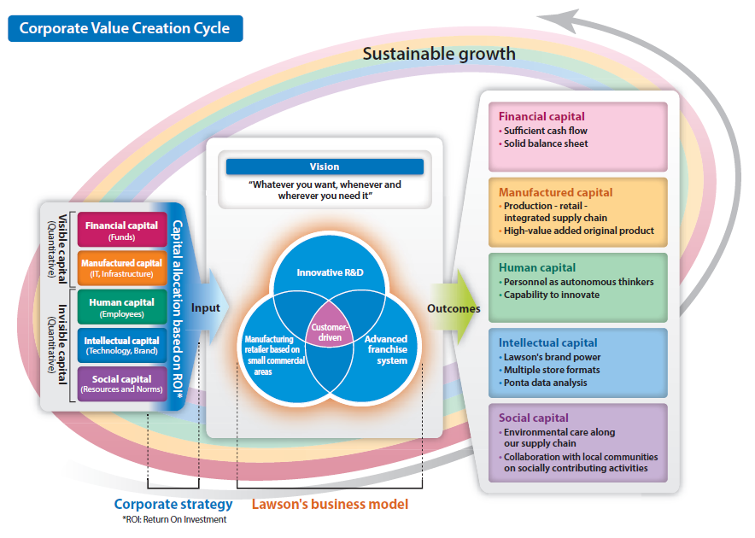
Lawson, Inc. Integrated Report 2013
Notes:
Similar to the Framework’s ‘Octopus’ shaped diagram, on the left, Lawson have demonstrated the capitals that go into Lawson’s Value Creation Cycle, in the centre, the strategy and vision of the business, and on the right hand side the Capital outcomes.

Slide 35
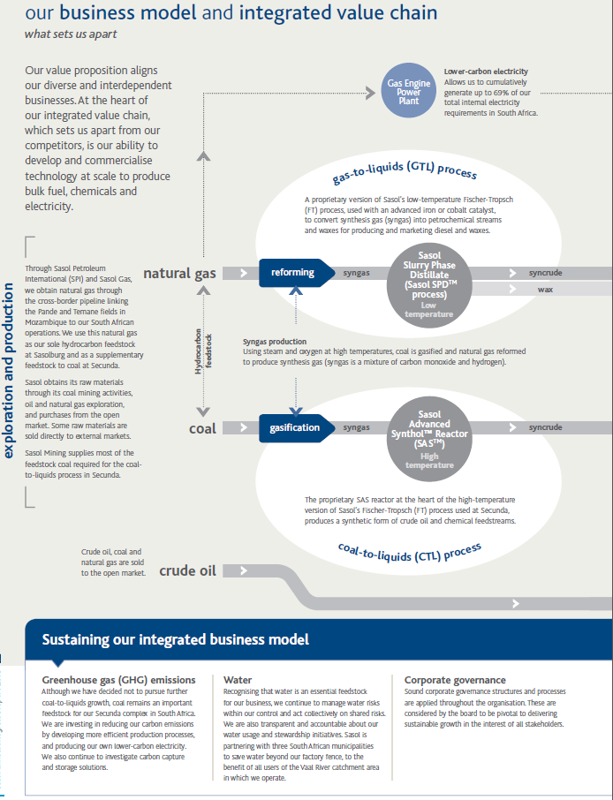
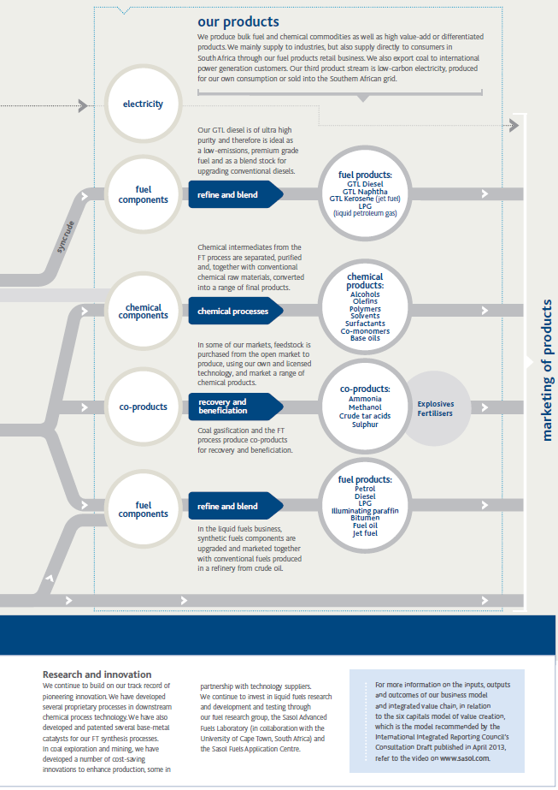
Sasol annual integrated report 2013
Notes:
Sasol presents an evolution of their business model which concisely provides an overview of the process through which the business goes to generate the end products, all the way through to marketing. Key to this business model is the identification of key inputs – natural gas, coal and crude oil – and describing the process through which they are transformed. Interestingly, Sasol also identifies supporting elements which ‘sustain our integrated business model’ which included GHG emissions, water, new energy, corporate governance, innovation and research. By highlighting these aspects the reader is able to grasp not only the key processes but also the vital resources.

Slide 36
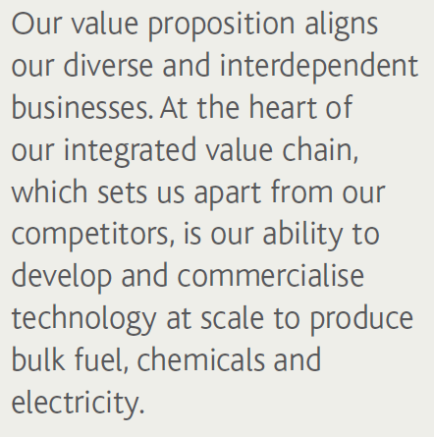
Sasol annual integrated report 2013
Notes:
An insight into Sasol’s integrated value chain and business model – and what sets them apart.

Slide 37
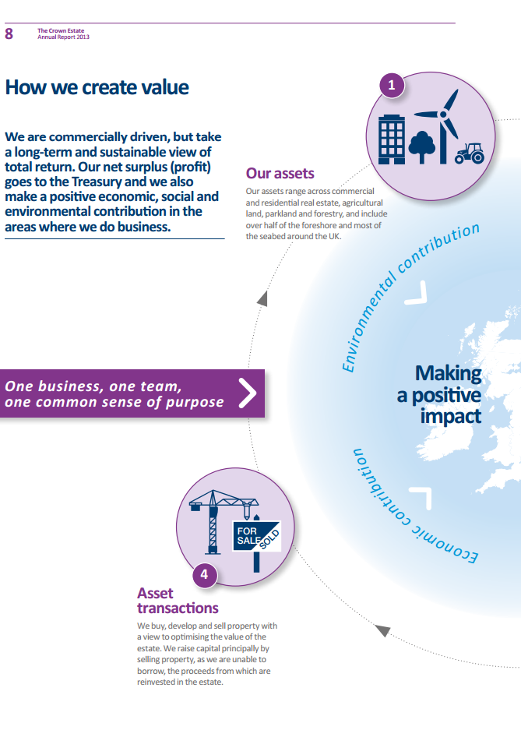
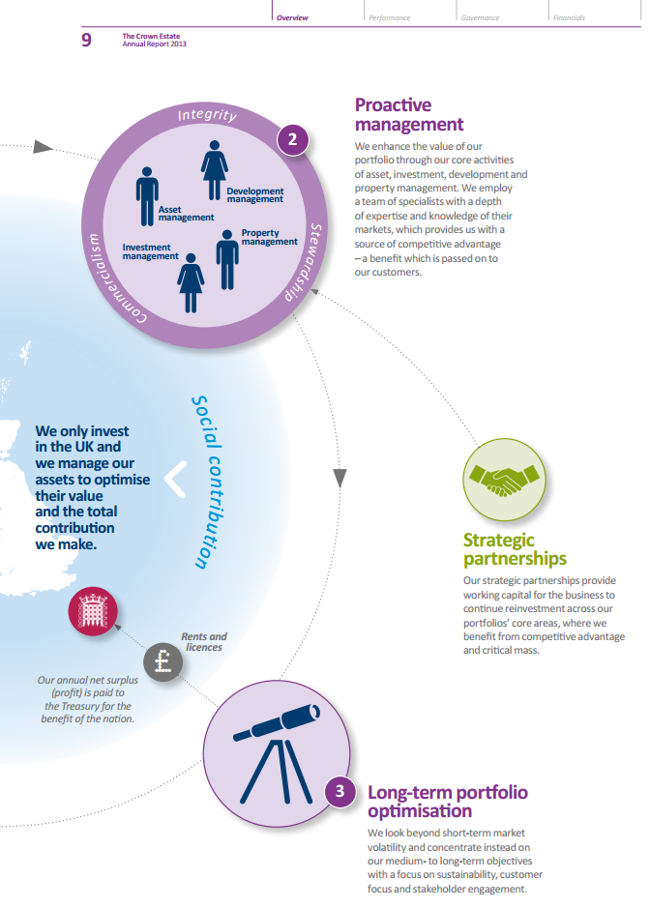
The Crown Estate Integrated Annual Report and Accounts 2013
Notes:
As part of The Crown Estate’s first Integrated Report, a concise and insightful narrative into how the business creates value is presented. This spread is integral to providing a rounded overview of the business, highlighting in particular what The Crown Estate does, where and how. The cycle through which value is created is outlined with a focus on how the business makes money, which gives the reader a clear sense of the economic contribution the business makes. Interestingly, emphasizing the focus which the business has on strategic partnerships and how the company contributes from a social, environmental and economic perspective helps to show the integrated nature of the business.

Slide 38
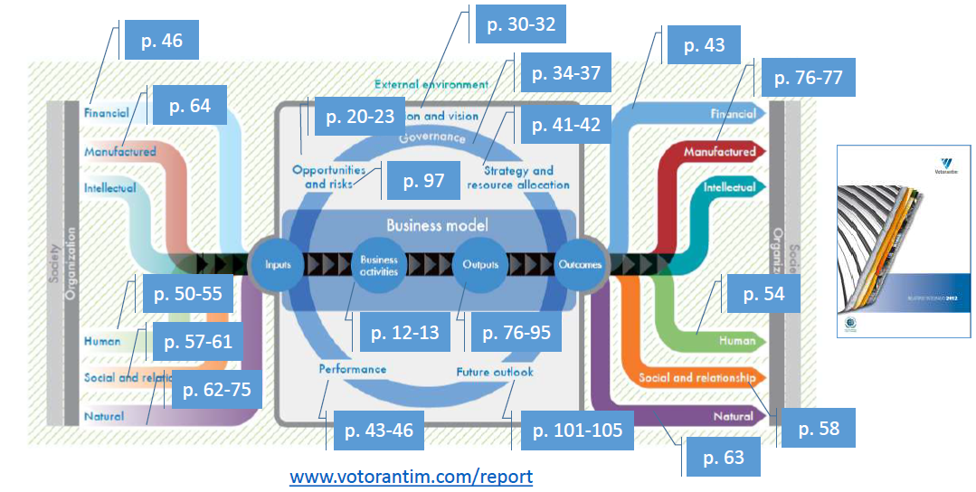
Votorantim link <IR> to their Report 2012
Notes:
Although this diagram was not included in Votorantim’s Annual Report, they have separately published this diagram to demonstrates that the Annual Report focuses on Integrated Reporting.

Slide 39
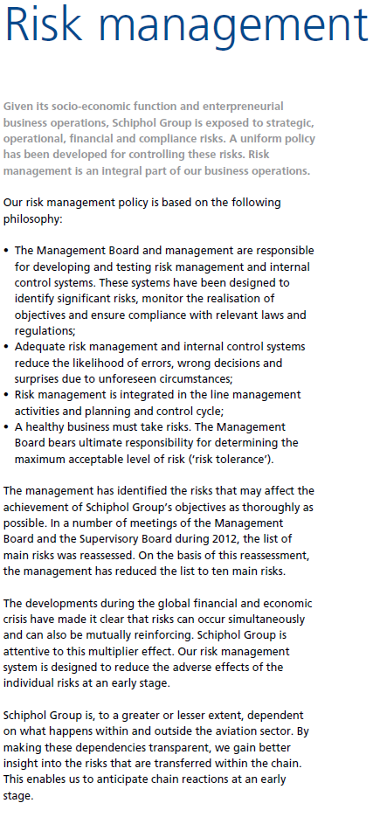
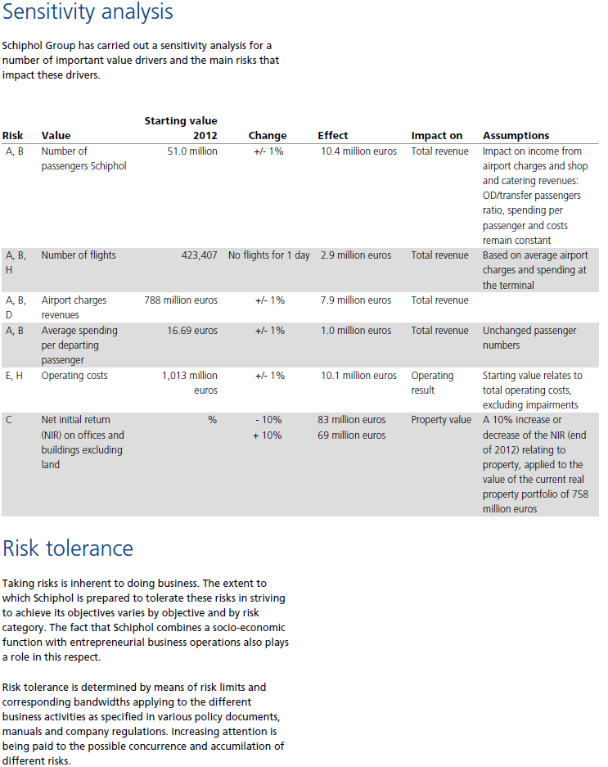
RISK AND OPPORTUNITY
Notes:
Emerging demonstrations of ‘Risk and Opportunity’

Slide 40
Schiphol Annual Report 2012
Notes:
As Schiphol have identified in the Annual Report, they are dependent on what happens within and outside the aviation sector.
The 10 main risks, have been identified by the Management Board and Supervisory Board and are broken down into 4 categories - Strategic, Operational, Financial, and Compliance. For each risk, Schiphol have concisely described the risk and identified the control measures.

Slide 41
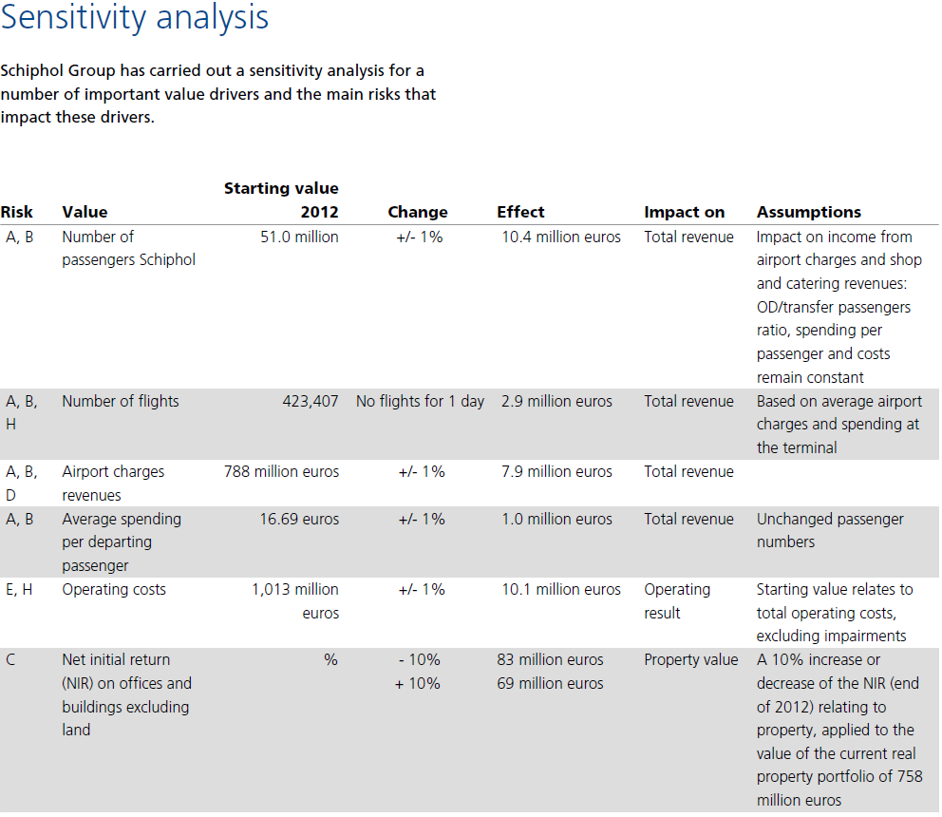
Schiphol Annual Report 2012
Notes:
To improve transparency on how changes in the environment impact the company, Schiphol have carried out a sensitivity analysis on key value drivers. Each value driver (e.g. number of passengers, operating costs) is linked to one or more of the 10 main risks, and shows the impact on total revenue or operating result of a 1% +/- change.

Slide 42
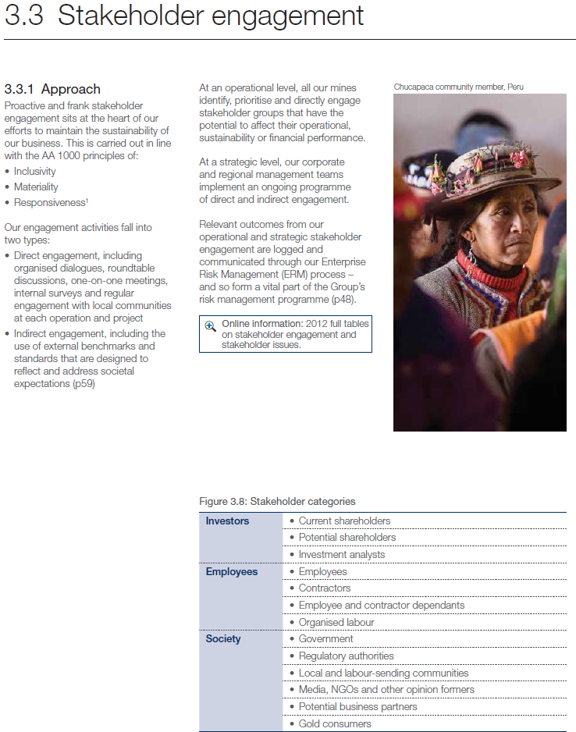
STRATEGY
Notes:
Emerging demonstrations of Strategy

Slide 43
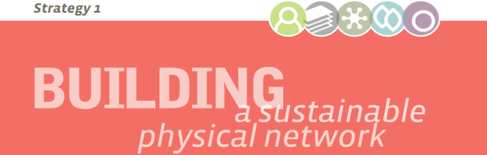

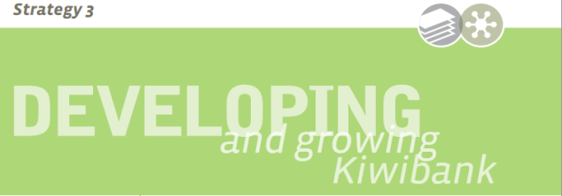
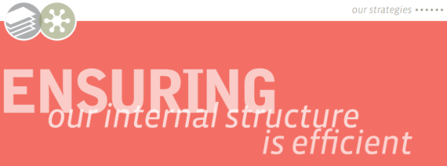
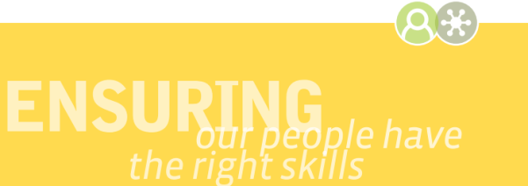
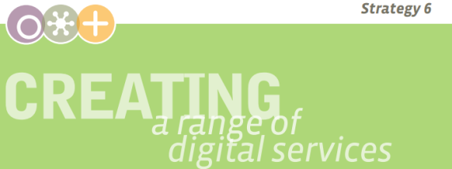
New Zealand Post Group Annual Review 2013
To build a sustainable physical network that offers the flexibility to align to changes in demand
(New Zealand Post Group Limited
Statement of Corporate Intent 2012-2015)
To develop and deliver, in an economic and sustainable way, a good customer experience, by providing effective products and services.
(New Zealand Post Group Limited
Statement of Corporate Intent 2012-2015)
To ensure long-term value creation for the Group through the further development and growth in Kiwibank.
(New Zealand Post Group Limited
Statement of Corporate Intent 2012-2015)
To ensure the internal structure, process and frameworks in operation at the New Zealand Post Group are positioned to offer the most efficient and profitable outcome for the Group
(New Zealand Post Group Limited
Statement of Corporate Intent 2012-2015)
To ensure that our people have the skills and capabilities they require to succeed, and to create a culture in the organisation that enables and encourages our people to strive for great customer outcomes
(New Zealand Post Group Limited
Statement of Corporate Intent 2012-2015)
To create a range of digital services to meet changing customer needs.
(New Zealand Post Group Limited
Statement of Corporate Intent 2012-2015)
Notes:
New Zealand Post Group have identified 6 key strategic focuses for value creation ranging from detailing its development plans; how to retain customers through good customer experiences; ensuring the internal structure is positioned to offer the most efficient and profitable outcome for the Group, and meeting changing customer needs through updating digital services.

Slide 44
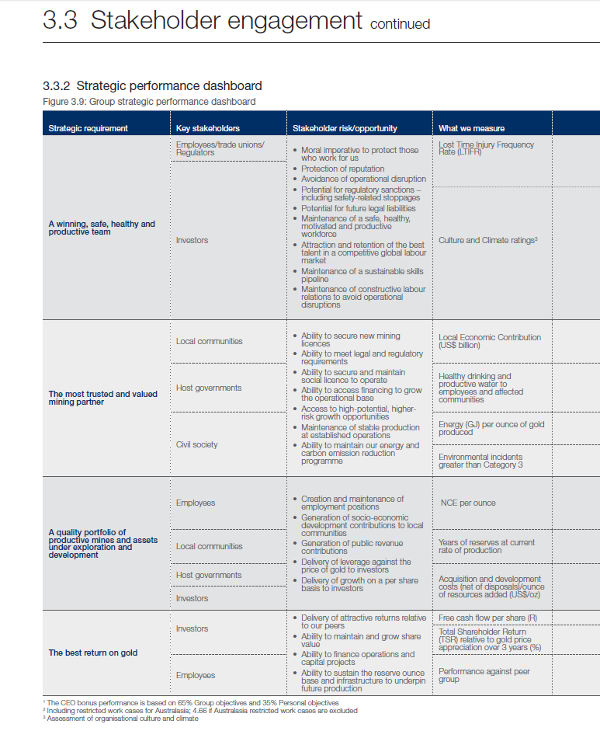
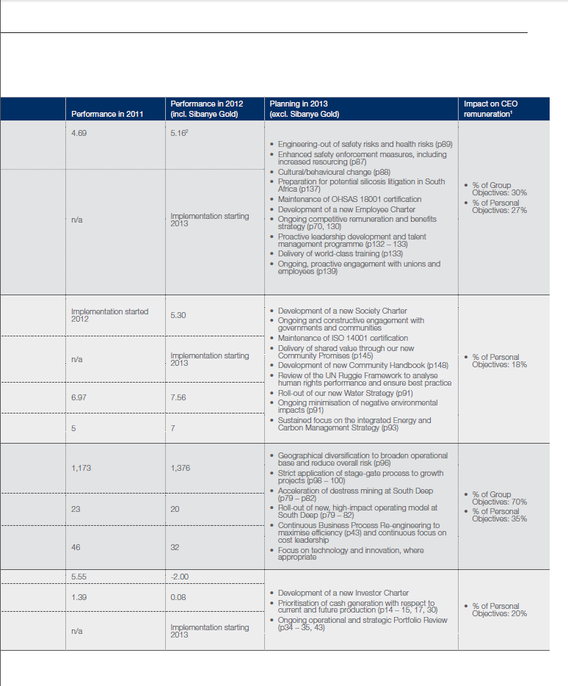
Gold Fields Integrated Annual Review 2012
Notes:
Gold Fields presents a stakeholder engagement section which provides additional depth in connectivity. After initially identifying the key stakeholders, a matrix is introduced whereupon the identified stakeholders are overlaid with the strategic elements of the business. For each group, the stakeholder risk/opportunity is identified along with the related key measures. The performance for this measure is then outlined for the past two years, followed by the plans for 2013.

Slide 45
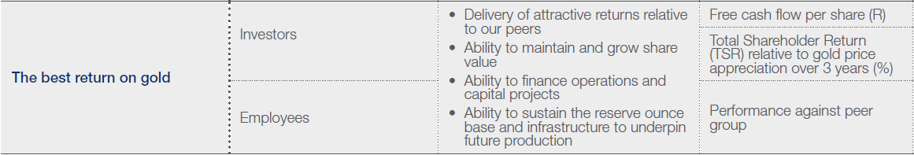
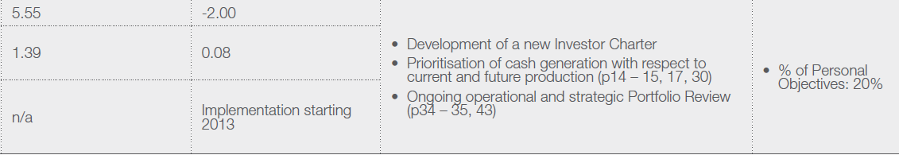
Gold Fields Integrated Annual Review 2012
Notes:
Within these plans, clear links to other areas of the Report are provided to allow the reader to navigate through the rest of the Report. The final and perhaps most unique feature of the matrix is the link to remuneration. For each strategic requirement, the percentage of executive pay which is reliant on the strategic elements is included to provide a clear line of sight between company strategy, stakeholders, performance and executive rewards.

Slide 46
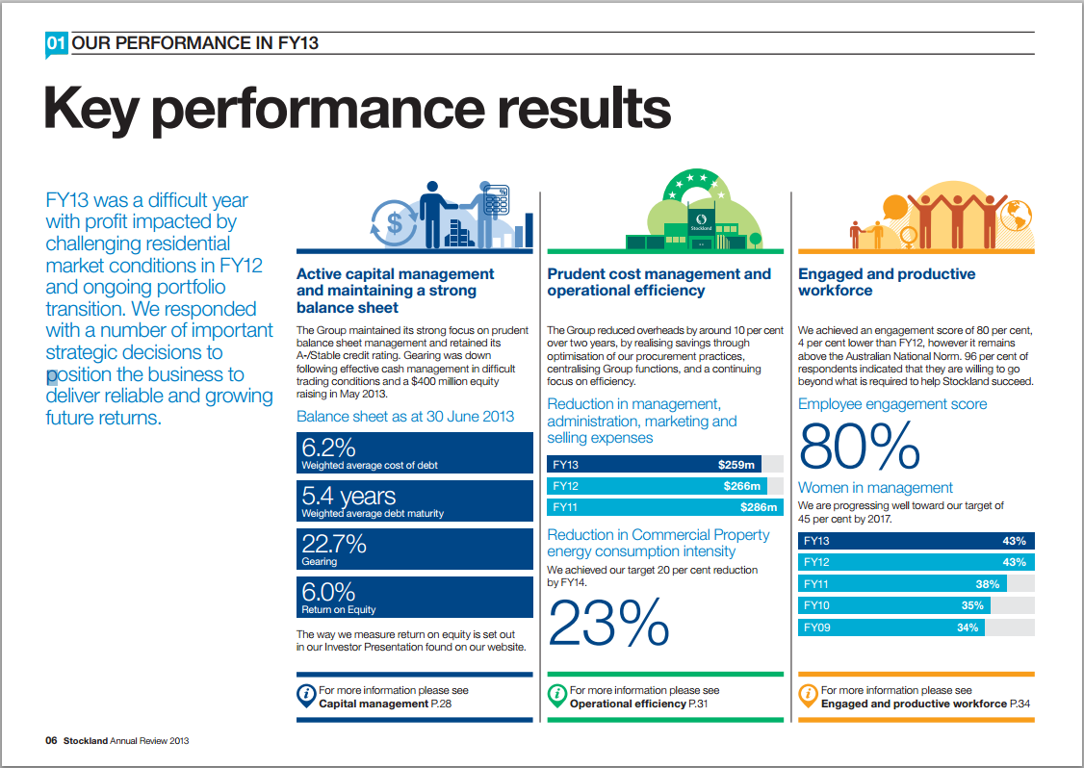
PERFORMANCE
Notes:
Emerging demonstrations of ‘Performance’

Slide 47
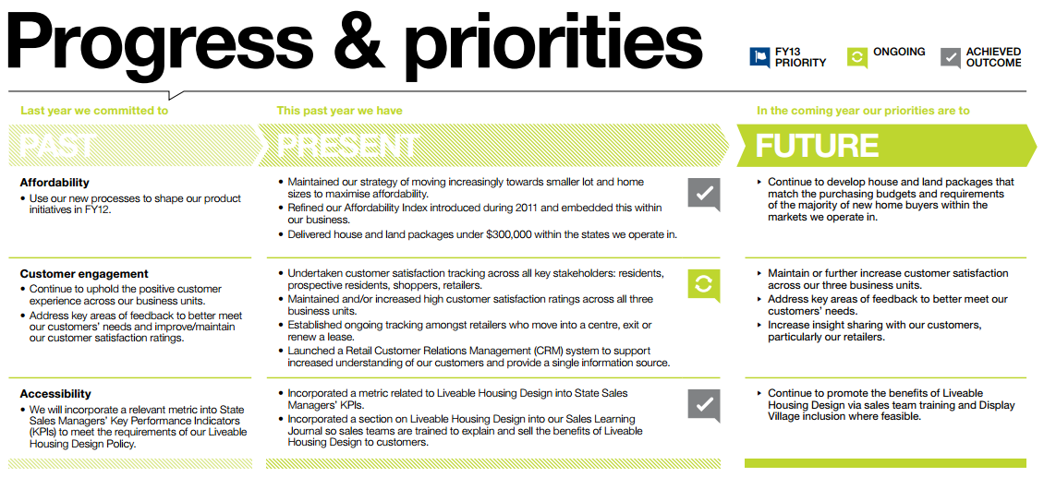
Stockland Annual Review 2012
Notes:
Under the headings ‘past’, ‘present’ and ‘future’ Stockland reviews what the company committed to in the prior year, before identifying exactly what progress was made. Using icons, the at-a-glance reader is able to grasp whether the objectives have been achieved, are on-going or have been converted into a priority for the coming year. This is followed with a column which outlines the priorities for the upcoming year. This summary is supplemented with a detailed narrative on performance and insightful case studies which highlights key achievements from the year.

Slide 48
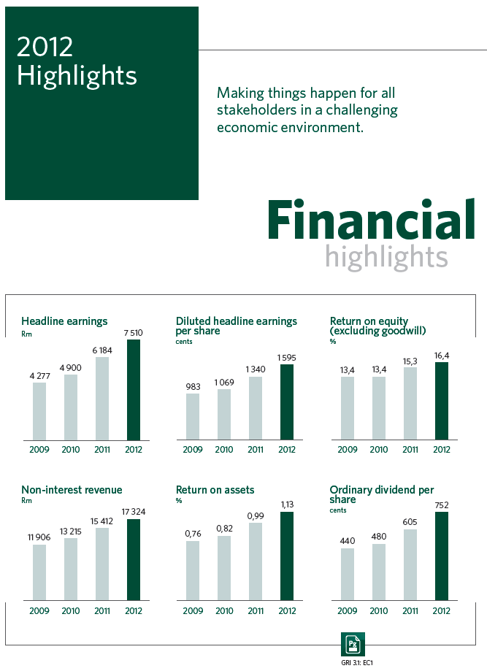
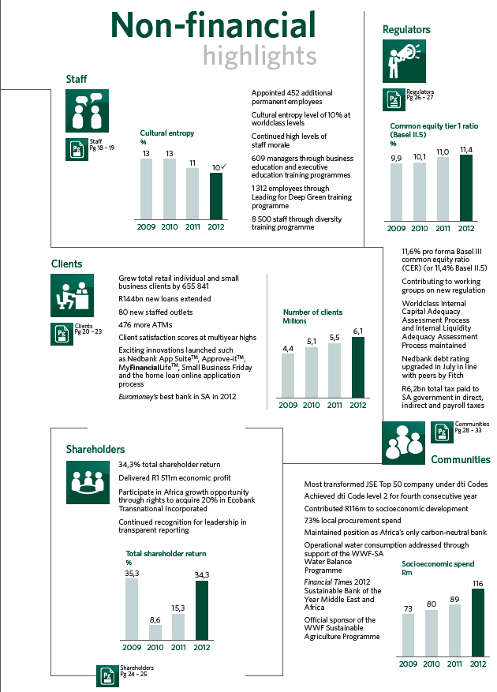
Nedbank Group Integrated Report 2012
Notes:
Demonstrating a clear balance between both financial and non-financial measures, Nedbank presents the 2012 highlights side-by-side in the opening pages of the Report.

Slide 49

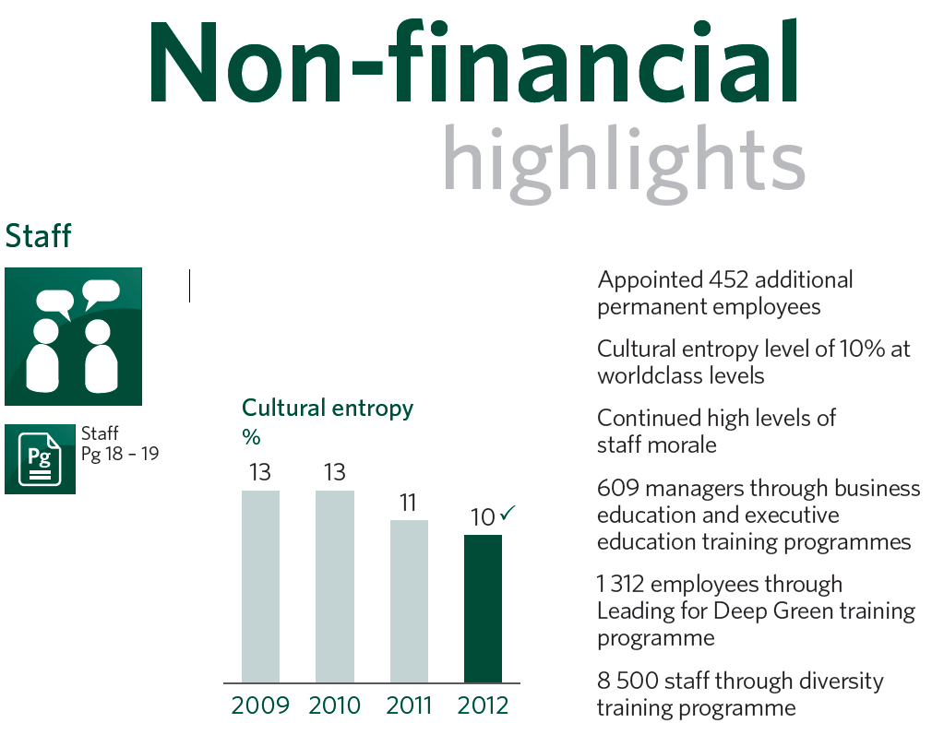
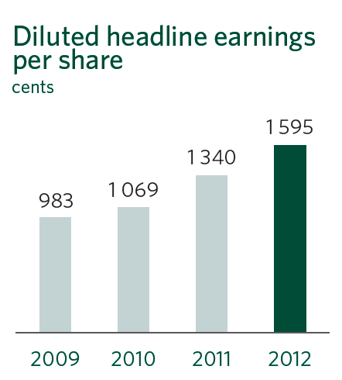
Nedbank Group Integrated Report 2012
Notes:
Interestingly, the non-financial highlights are split by key stakeholder groups with clear page references to further information. The use of icons to represent the different stakeholder groups is introduced here and these icons are then used throughout the Report to indicate relevant information for the stakeholder groups.

Slide 50
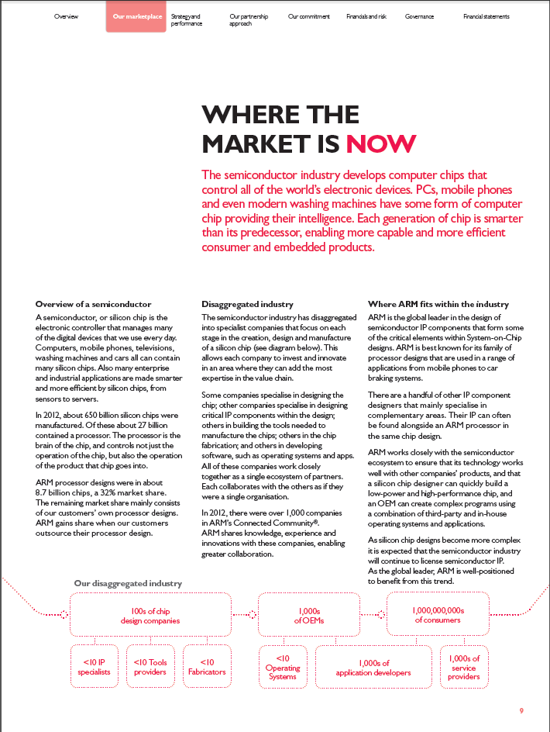
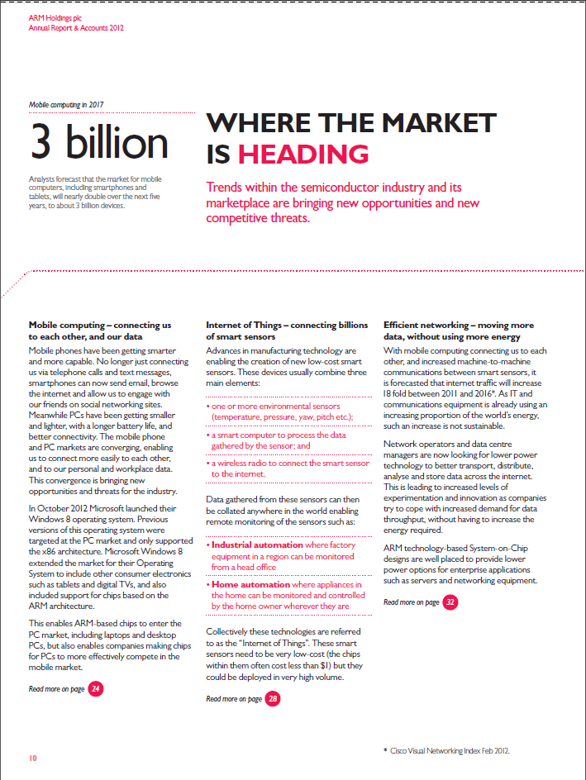
OUTLOOK
Notes:
Emerging demonstrations of ‘Outlook’

Slide 51
ARM Holdings plc Annual Report & Accounts 2012
Notes:
ARM Holdings provides a comprehensive yet concise insight into the semi-conductor business and the way in which ARM Holdings fits within the industry.

Slide 52
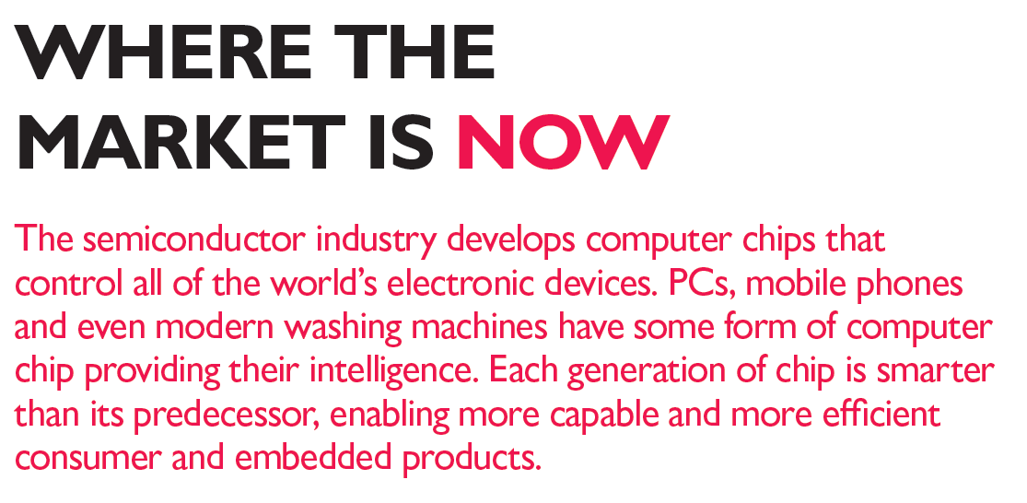
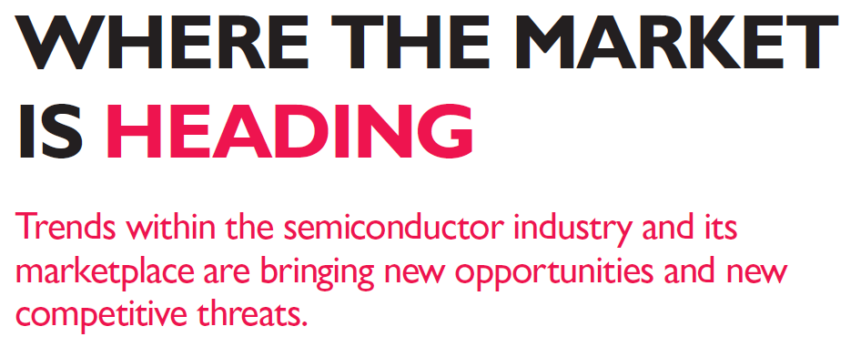
ARM Holdings plc Annual Report & Accounts 2012
Notes:
Interestingly the market discussion, which examines key macro-economic trends and industry specific trends, is split into two sections; ‘where the market is now’ and ‘where the market is heading’. In an accessible and understandable way ARM Holdings provides the reader with a great deal of information on a complex industry, while examining the current state of the market and its evolution in the future.

Slide 53
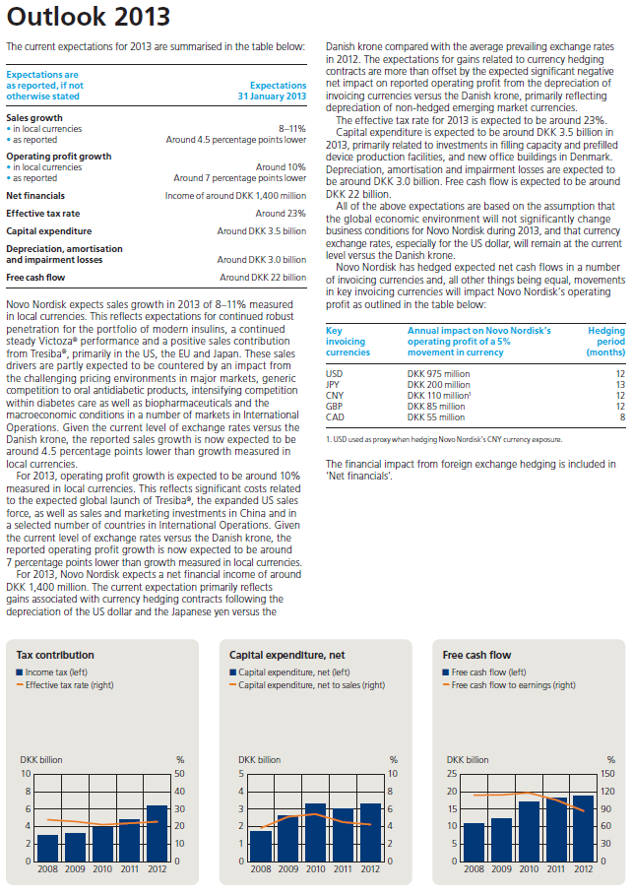

Novo-Nordisk Annual Report 2012
Notes:
Novo Nordisk provides specific forward looking financial information on sales growth, operating profit growth and cash flow for the upcoming year. Discussion of each measure centres on the assumptions being made by the company and also highlights the uncertainties they might face in achieving these goals.

Slide 54




Resources
www.theiirc.org
Emerging <IR> Database
IIRC Pilot Programme Yearbooks
Notes:
The IIRC has the following resources:
The Emerging <IR> Database is a tool for displaying the new and exciting ways in which the Guiding Principles and Content Elements of <IR> are beginning to be applied.
The IIRC Pilot Programme Yearbooks detail the journeys of the IIRC Pilot Programme businesses and investors as they work towards <IR>. It describes how businesses are connecting departments, and developing their strategies for longer term value creation.

Slide 55
International
Integrated Reporting
Council

